Slide 1
n Campaign By Jefferson County Public Schools in Louisville, KY
V
Vaping Equals ______________________
An Awareness and Prevention Campaign
By Jefferson County Public Schools in Louisville, KY

Slide 3
Dr. Pat Withrow – Director of physician outreach for Baptist Health
Some students tell me they can consume an entire pod of nicotine from a Juul in 45 seconds or less

Slide 4
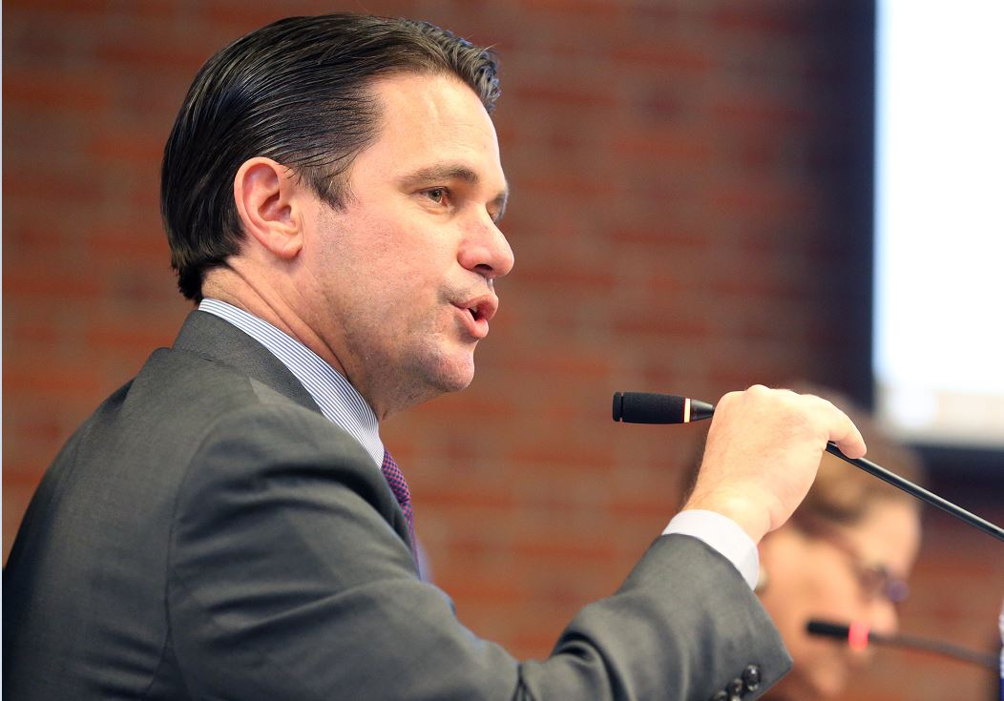
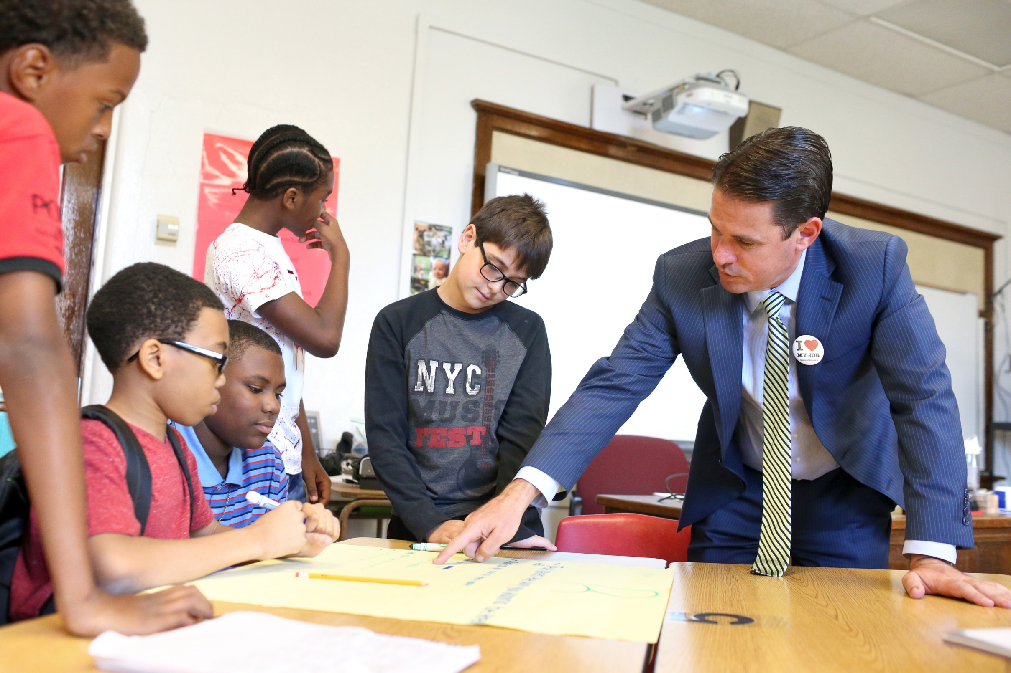

Slide 8
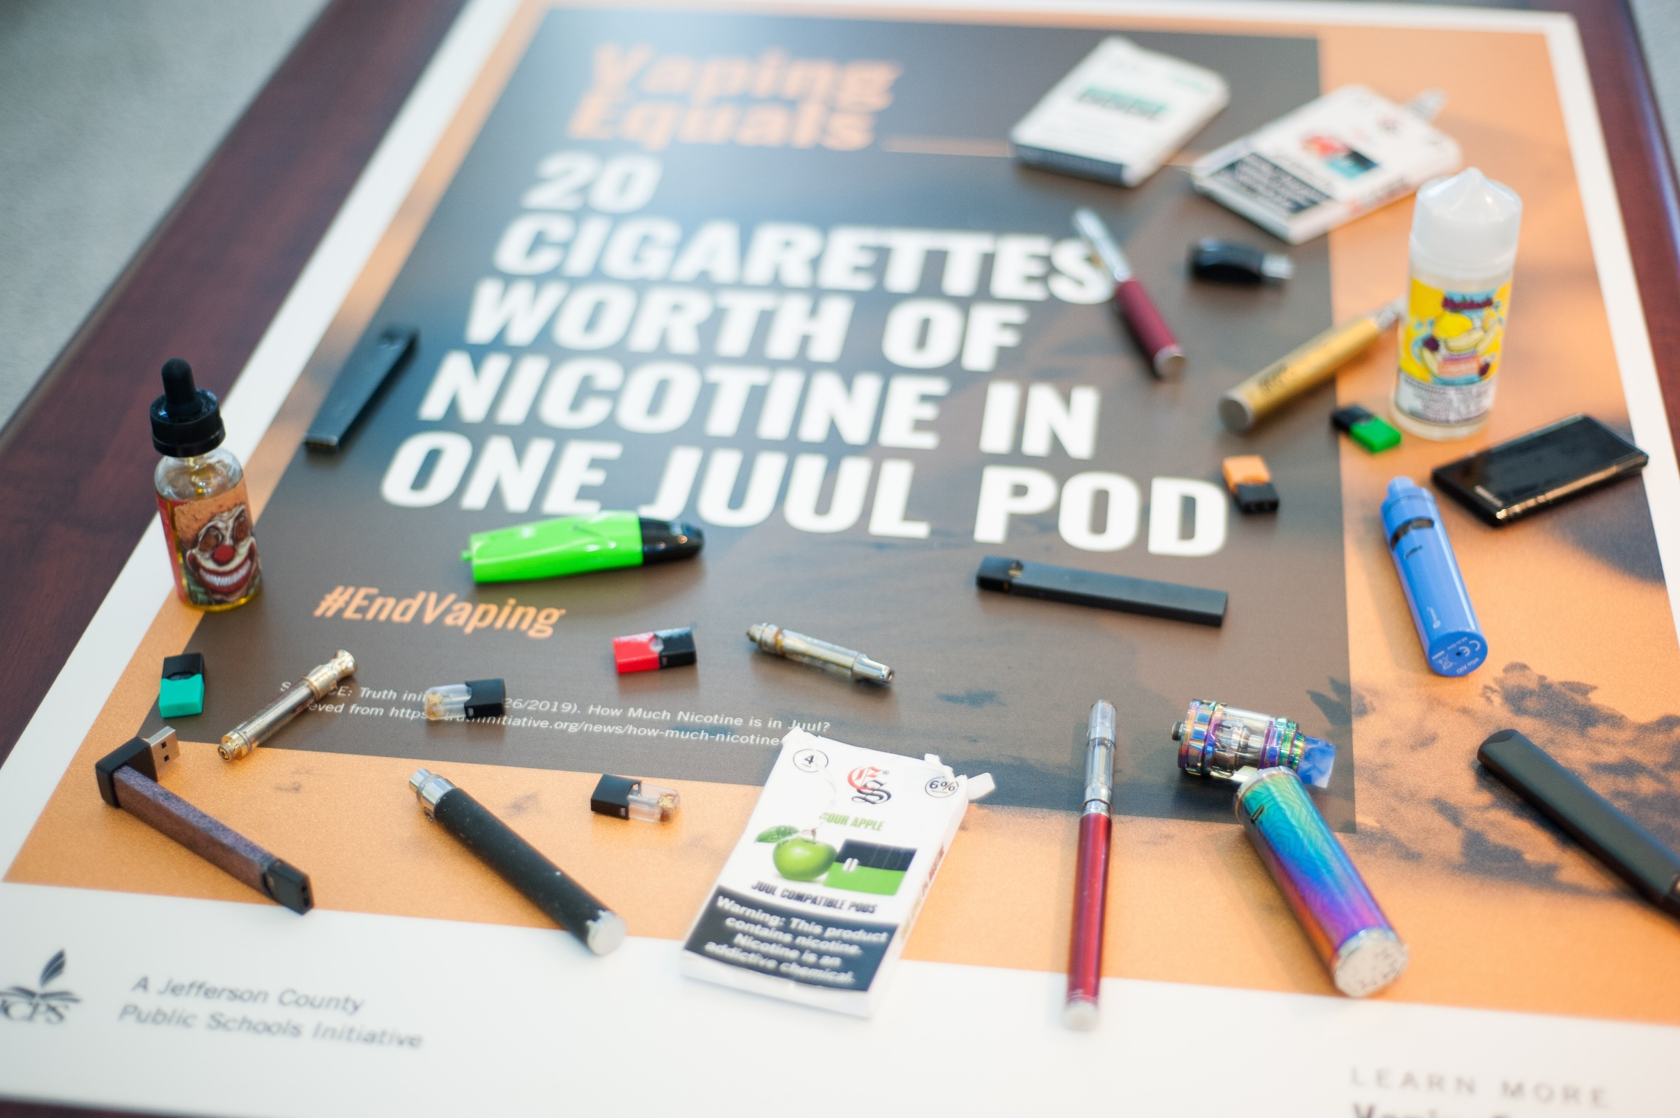

Slide 9
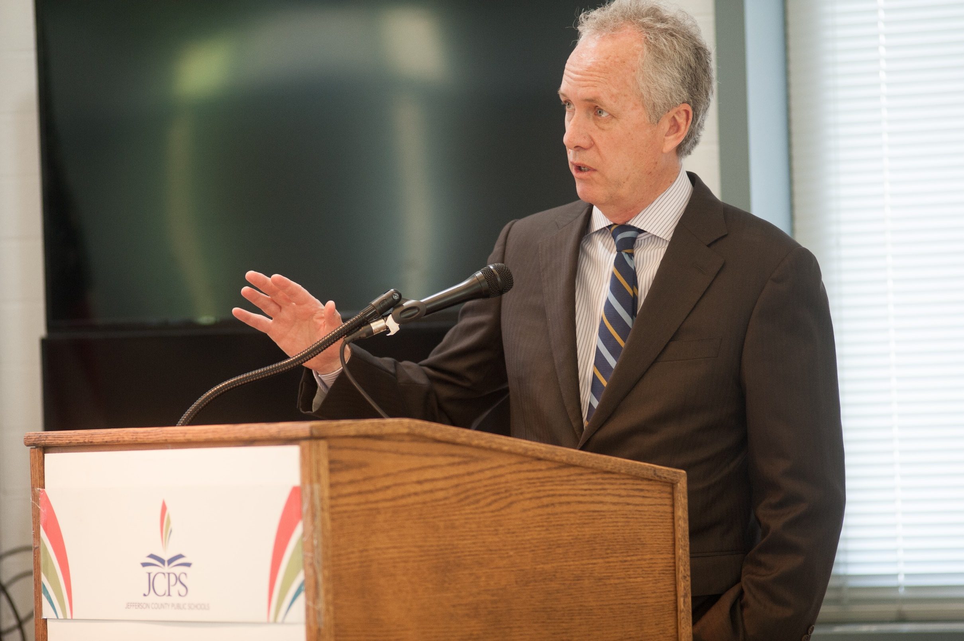

Slide 12
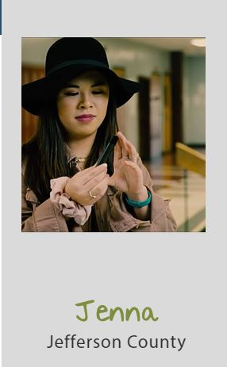

Slide 14
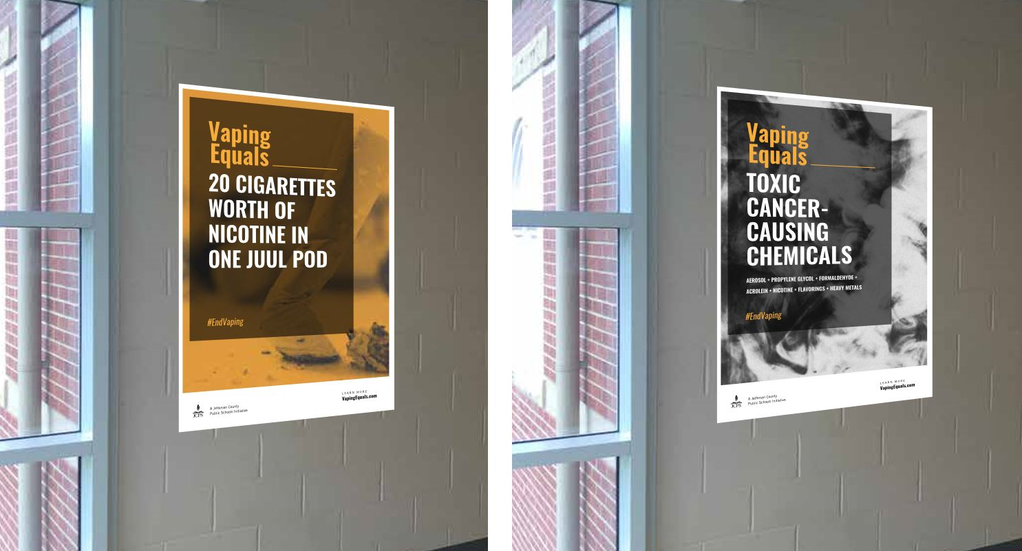

Slide 15
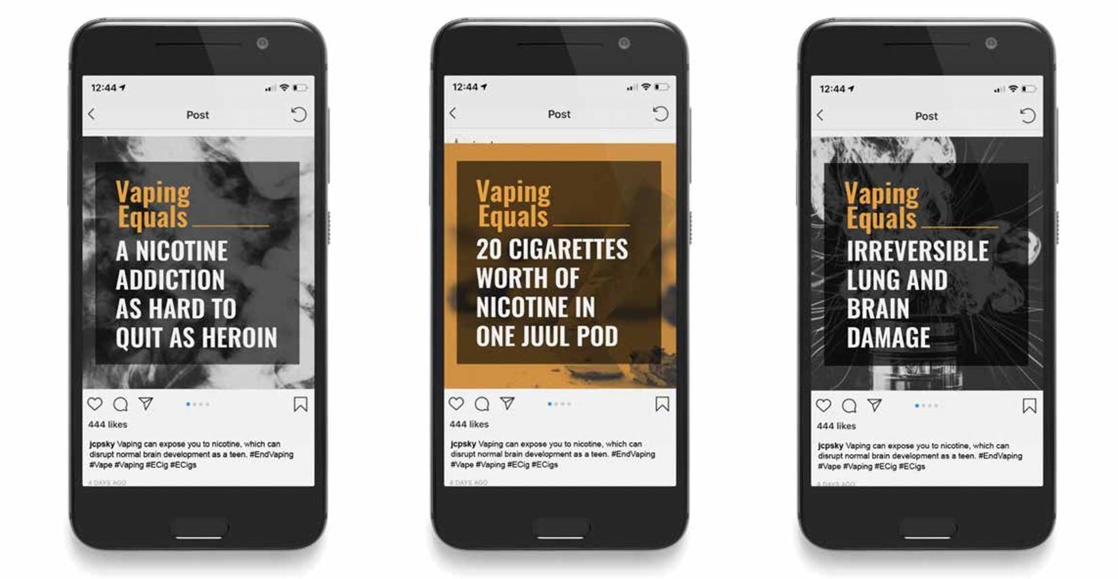

Slide 16
Measure success
Still in the process of doing that –
Increased awareness
Less attempts of vaping among students
An increase of student lead initiaitives to educate peers
Parent knowledge

Slide 17
Feedback

